Slide 1


Inventing Merit Badge
Troop 344 and 9344
Pemberville, OH

Slide 2
*Before you begin building the prototype, you must share your design and building plans with your counselor and have your counselor’s approval
Inventing Merit Badge Requirements
In your own words, define inventing. Then do the following:
  Explain to your merit badge councilor the role of inventors and their inventions in the economic development of the United States.
  List three inventions and how they have helped humankind.
Do ONE of the following:
  Identify and interview with a buddy (and with your parent’s permission and merit badge counselor’s approval) an individual in your community who has invented a useful item. Report what you learned to your counselor.
  Read about three inventors. Select the one you find most interesting and tell your counselor what you learned.

Slide 3
*Before you begin building the prototype, you must share your design and building plans with your counselor and have your counselor’s approval
Inventing Merit Badge Requirements
Do EACH of the following:
  Define the term intellectual property. Explain which government agency oversees the protection of intellectual property, the types of intellectual property that can be protected, how such property is protected, and why protection is necessary.
  Explain the components of a patent and the different types of patents available.
  Examine your Scouting gear and find a patent number on a camp item you have used. With your parent’s permission, use the Internet to find out more about that patent. Compare the finished item with the claims and drawings in the patent. Report what you learned to your counselor.
  Explain the term patent infringement.

Slide 4
*Before you begin building the prototype, you must share your design and building plans with your counselor and have your counselor’s approval
Inventing Merit Badge Requirements
Discuss with your counselor the types of inventions that are appropriate to share with others without protecting and explain why. Tell your counselor about one unpatented invention and its impact on society.
Choose a commercially available product that you have used on an overnight camping trip with your troop. Make recommendations for improving the product, make a sketch that shows your recommendations, and discuss your recommendations with your counselor.

Slide 5
*Before you begin building the prototype, you must share your design and building plans with your counselor and have your counselor’s approval
Inventing Merit Badge Requirements
Think of an item you would like to invent that would solve a problem for your family, troop, chartered organization, community, or a special-interest group. Then do EACH of the following, while keeping a notebook to record your progress:
  Talk to potential users of your invention and determine their needs. Then, based on what you have learned, write a proposal about the invention and how it would help solve a problem. This proposal should include a detailed sketch of the invention.
  Create a model of the item using clay, cardboard, or any other readily available material. List the materials necessary to build a prototype of the item.
  Share the idea and model with your counselor and potential users of your invention. Record their feedback in your notebook.

Slide 6
*Before you begin building the prototype, you must share your design and building plans with your counselor and have your counselor’s approval
Inventing Merit Badge Requirements
Build a working prototype of the item you invented for requirement 6*, then test and evaluate the invention. Among the aspects to consider in your evaluation are cost, usefulness, marketability, appearance, and function. Describe how your initial vision and expectations for your idea and the final product are similar or dissimilar. Have your counselor evaluate and critique your prototype.
*Before you begin building the prototype, you must share your design and building plans with your counselor and have your counselor’s approval.

Slide 7
*Before you begin building the prototype, you must share your design and building plans with your counselor and have your counselor’s approval
Inventing Merit Badge Requirements
Do ONE of the following:
  Participate in an invention, science, engineering, or robotics club or team that builds a useful item. Share your experience with your counselor.
  Visit a museum or exhibit dedicated to an inventor or invention, and create a presentation of your visit to share with a group such as your troop or patrol.
Discuss with your counselor the diverse skills, education, training, and experience it takes to be an inventor. Discuss how you can prepare yourself to be creative and inventive to solve problems at home, in school, and in your community. Discuss three career fields that might utilize the skills of an inventor.

Slide 8

Requirement 1
In your own words, define inventing. Then do the following:
  Explain to your merit badge councilor the role of inventors and their inventions in the economic development of the United States.
  List three inventions and how they have helped humankind.

Slide 9

What Is Inventing?
Inventing is the process of finding technological solutions to real world problems.
Inventiveness is a form of creative problem solving that results in an invention.
An invention is the product of the inventing process.

Slide 10
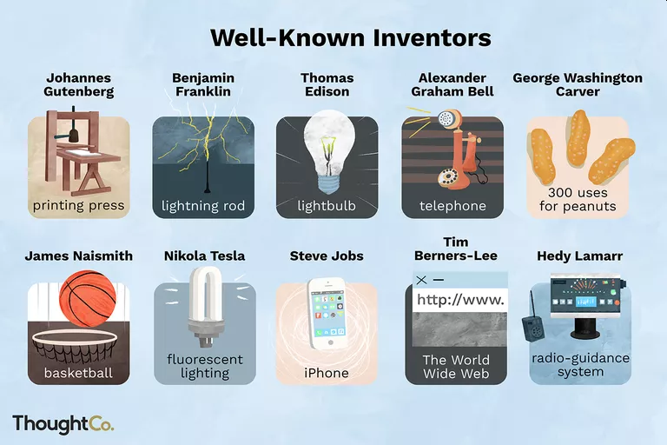
The Role of Inventors and Inventions
Create new products to sell
More efficient ways to do things
Extend and improve life of citizens
Provide more leisure time for recreation
Makes life more enjoyable

Slide 11

Requirement 1
In your own words, define inventing. Then do the following:
  Explain to your merit badge councilor the role of inventors and their inventions in the economic development of the United States.
  List three inventions and how they have helped humankind.

Slide 12
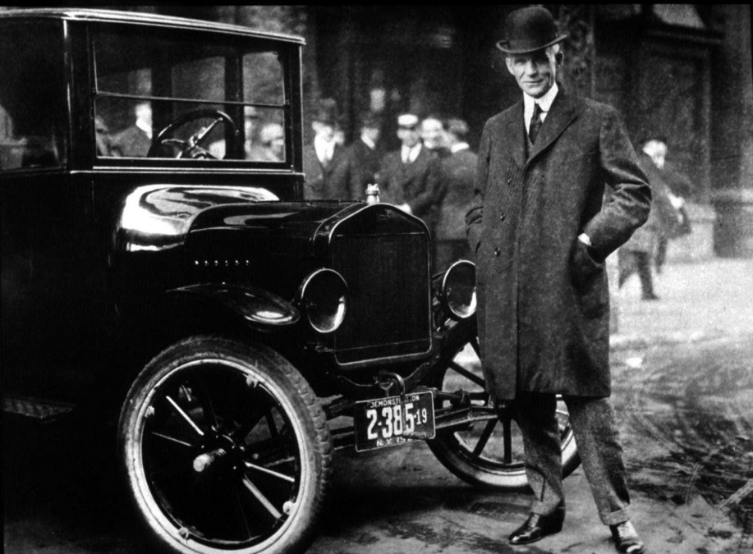
Henry Ford
In 1913, Henry Ford adopted the assembly line manufacturing process, revolutionizing the automobile industry.
By 1915, the millionth Model T had rolled off the assembly line.
At an average cost of about $500 each, cars became affordable for the first time for many American families.
The widespread availability of cars created the need for a range of innovations:
  New road systems, laws, service stations, and repair shops.

Slide 13
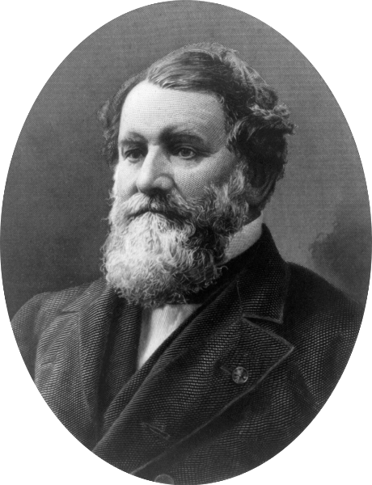
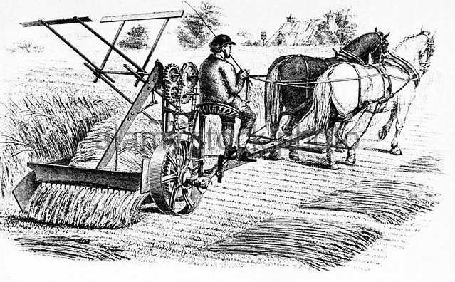
Cyrus McCormick
Cyrus McCormick is called the “father of modern agriculture” because he invented the first successful mechanical reaper in 1831 when he was 22 years old.
With his reaper, McCormick single-handedly increased the potential yield of farming at least tenfold, with a minimum of effort by farmers.
The reaper was the beginning of a new mechanical harvesting industry that made significant contributions to the prosperity of Americans.

Slide 14
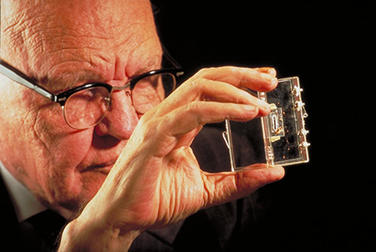
Jack Kilby
For one invention alone, Jack Kilby can be justly considered one of the greatest electrical engineers of all time.
He invented the monolithic integrated circuit, or microchip, which made microprocessors possible, thereby allowing high-speed computing and communications systems to become efficient, convenient, affordable, and used everywhere.

Slide 15
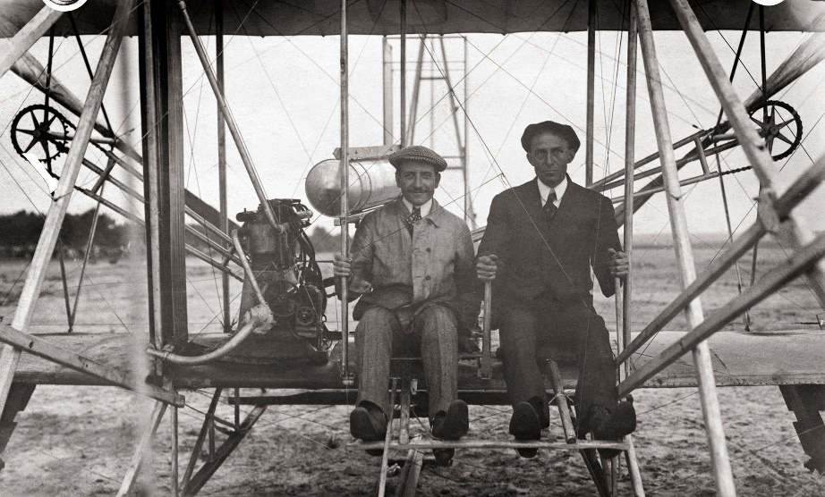
Wright Brothers
The airplane is without a doubt the most influential invention of the 20th century, simply because it shrunk the world.
It has connected nations that would have never been connected otherwise, and shown us a new, unseen and spectacular perspective of our earth.
Airplanes have also contributed to improving many economies and there are many jobs that would not be there if it was not for airplanes, like pilots and aircraft technicians.

Slide 16
Requirement 2
Do ONE of the following:
  Identify and interview with a buddy (and with your parent’s permission and merit badge counselor’s approval) an individual in your community who has invented a useful item. Report what you learned to your counselor.
  Read about three inventors. Select the one you find most interesting and tell your counselor what you learned.

Slide 17
Locating Inventors
Can you locate an inventor in your community? Listed below are a few suggestions to help you.
  Ask the reference librarian at your local library.
  Talk to an engineer or entrepreneur.
  Call a local manufacturing business.
  Use the Internet (always with your parent’s permission first).
    FreePatentsOnline
    This free search engine is fast and easy.
    To search for a patent that was granted to an inventor in your community, use the Quick Search tab and fill in the name of your city and state.

Slide 18
Requirement 2
Do ONE of the following:
  Identify and interview with a buddy (and with your parent’s permission and merit badge counselor’s approval) an individual in your community who has invented a useful item. Report what you learned to your counselor.
  Read about three inventors. Select the one you find most interesting and tell your counselor what you learned.

Slide 19
Reading About Inventors
Read about these inventors in the Inventing Merit Badge Pamphlet or research them on the internet.
  From Bridges to Backpacks - John Fabel
  Who Says You Can’t Rappel…in Reverse? - Nate Ball
  A Street-Legal Airplane - Carl Dietrich

Slide 20
Requirement 3
Do EACH of the following:
  Define the term intellectual property. Explain which government agency oversees the protection of intellectual property, the types of intellectual property that can be protected, how such property is protected, and why protection is necessary.
  Explain the components of a patent and the different types of patents available.
  Examine your Scouting gear and find a patent number on a camp item you have used. With your parent’s permission, use the Internet to find out more about that patent. Compare the finished item with the claims and drawings in the patent. Report what you learned to your counselor.
  Explain the term patent infringement.

Slide 21

Intellectual Property
The term "intellectual property" “refers to creations of the mind, such as inventions; literary and artistic works; designs; and symbols, names and images used in commerce.”

Slide 22

United States Patent and Trademark Office
The government agency that oversees the protection of intellectual property in the United States is the United States Patent and Trademark Office (USPTO).

Slide 23
Types of Intellectual Property
In the U.S., there are several types of intellectual property, which include patents, trade marks, copyrights, and trade secrets.
  Patents allow their owner to determine who can make, use, or sell an invention.
  Trade marks allow their owner to communicate the source or origin of a product or service to consumers.
  Copyrights provide their owner with the ability to determine who can reproduce or distribute a work, publicly perform and display a work, or prepare derivative works.
  Trade secrets protect confidential business information.

Slide 24
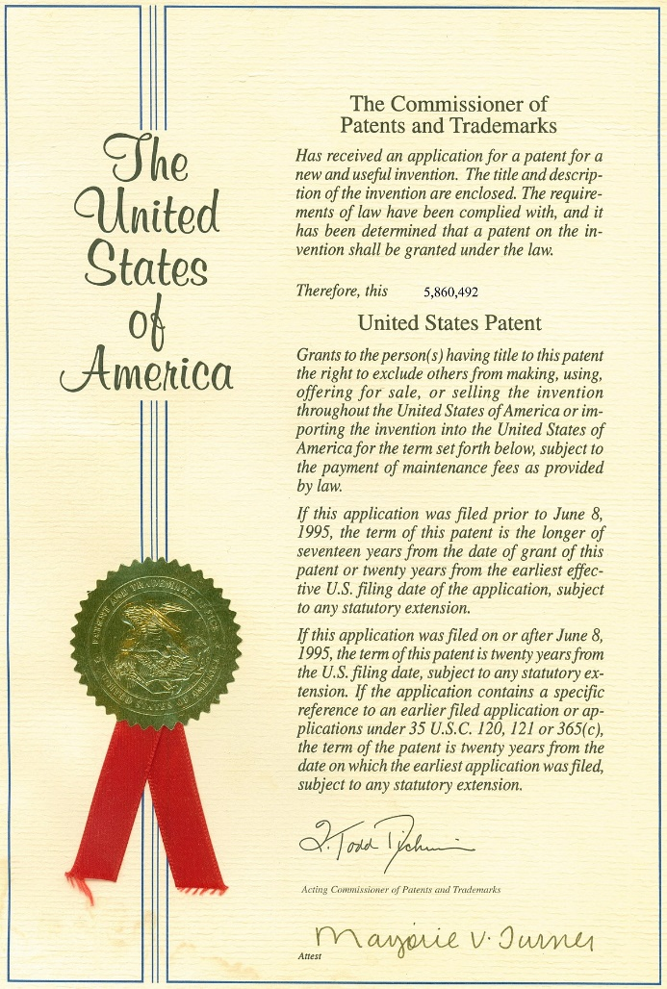
Patent
A utility patent protects a new and useful process, machine, article of manufacture, or composition of matter, or any new and useful improvement thereof.
To obtain a patent in the U.S., the inventor must file a patent application with the United States Patent and Trademark Office (USPTO), which includes
  a written document comprising a description and claims,
  drawings when necessary,
  an oath or declaration, and
  filing, search, and examination fees.
Patent protection lasts 20 years from the date of filing

Slide 25

Trademarks
A trademark or service mark is a word, phrase, symbol, or design, or a combination thereof, that identifies and distinguishes the source of the goods or services of one party from those of others.
A U.S. trademark generally lasts as long as the trade mark continues to be used and is defended against infringement.
Trademark Symbols

Slide 26

Trademark
Word, name, symbol, device, or any combination to identify and distinguish the goods/services of one seller or provider from those of others
  ™ - Unregistered Trademark (free)
  ® - Registered Trademark (requires registration, fee and use)
Must register to litigate
Perpetual rights if maintained - used and pay fees

Slide 27


Copyright
Copyright in the U.S. protects “original works of authorship” from the time the works are created in a fixed form.
Although registration is not required for protection, it offers many benefits, including a public record of the copyright claim, evidence of the validity of the copyright when registration is made before or within five years of publication, and the possible recovery of damages and attorney’s fees and costs in successful copyright infringement litigation.
In general, the term of copyright is the life of the author plus 70 years after the author’s death (or last surviving author’s death if a joint work). For works made for hire and anonymous or pseudonymous works, the duration of copyright is 95 years from publication or 120 years from creation, whichever is shorter. (Works created before January 1, 1978, have special rules of duration).

Slide 28

Why Didn’t They Sing Happy Birthday at Chucky Cheese’s®?
The melody of "Happy Birthday to You" comes from the song "Good Morning to All“ written by Patty and Mildred Hill in 1893
Warner/Chappell claims to have bought the rights for the words to “Happy Birthday to You” from the sister’s publisher and the copyright was valid until 2030
Warner has collected millions of dollars over the years in license fees
In 2015 Chief U.S. District Judge George King ruled that there is no evidence that there was ever a copyright on the “Happy Birthday to You” lyrics and any copyright to the music would have expired long ago.
Last year, Warner/Chappell paid $14,000,000 in a settlement to people who paid royalties in the past.
You can now sing “Happy Birthday to You” without a license!

Slide 29

Trade Secrets
Trade secrets are protected in the U.S. as long as the information is a secret, has commercial value, and reasonable steps are taken to protect the information.
Illegal to disclose trade secrets protected under non-disclosure agreement.
Theft protected by federal and state laws.
Lost if discovered independently by someone else.

Slide 30
Requirement 3
Do EACH of the following:
  Define the term intellectual property. Explain which government agency oversees the protection of intellectual property, the types of intellectual property that can be protected, how such property is protected, and why protection is necessary.
  Explain the components of a patent and the different types of patents available.
  Examine your Scouting gear and find a patent number on a camp item you have used. With your parent’s permission, use the Internet to find out more about that patent. Compare the finished item with the claims and drawings in the patent. Report what you learned to your counselor.
  Explain the term patent infringement.

Slide 31
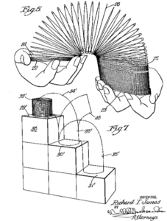
Components of a Patent
The typical patent consists of four main parts:
  Front page(s)
  Drawings
  Specification
    A background section
    A list of drawings
    A detailed description
  Claims

Slide 32
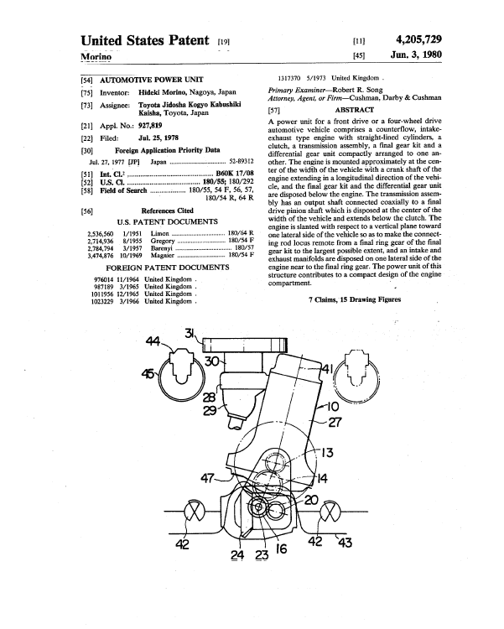
Front Page of a Patent
The Title, Abstract, and Drawings provided on the front page simply summarize the technology described in the patent.
They are not the primary sources for determining what the patent actually covers (that’s laid out in the Claims at the end of the patent).

Slide 33
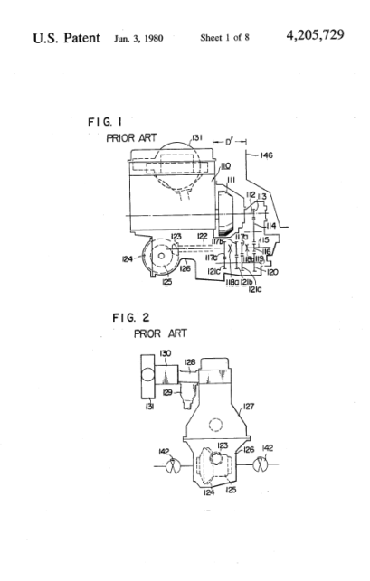
Drawings of a Patent
With a few rare exceptions (for example, if the invention relates to a chemical compound or composition), most U.S. patents will include drawings.
Located immediately following the front page, the drawings help the reader to understand the invention. The drawings must show all claimed elements.
Drawings labeled “Prior Art”, such as Figures 1 and 2 in the example above, are not part of the patented invention. But they’re used to document any prior processes that existed before the invention was made.

Slide 34
Specifications of a Patent
The "specification" of a patent is all of the written part of the patent, except for the first-page information and the claims.
A patent specification is a highly technical legal document, the purpose of which is to disclose an invention to the public in language that will enable the public to work the invention when relevant patent rights have expired; and to identify the subject matter that the patent applicant or patent owner intends to claim exclusively for themselves.
The Specification has a:
  Background section
    Briefly describes the invention but says very little about the invention.
  A list of drawings
  A detailed description
    The detailed description is the main technical disclosure of the patent.
    This section describes the invention in terms that would allow a person with ordinary skill to be able to make or use the invention. The detailed description also describes the best mode for making and using the inventions.

Slide 35
Claims of a Patent
The most important part of the document, the claims set forth and define the patent’s scope of exclusive rights. In other words, they describe what the patent does or does not cover. Each claim element should be shown in the drawings and described in the detailed description.
There are two different ways to categorize the types of claims you’ll find in a typical patent.
  System claims generally describe tangible things. The “elements” of a system claim are components of the system.
  Method claims generally describe a process or series of steps. The “elements” of the method claim are the operations themselves.

Slide 36
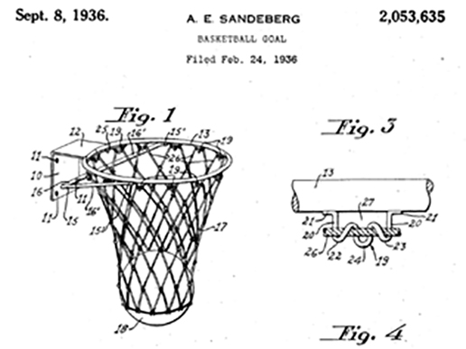
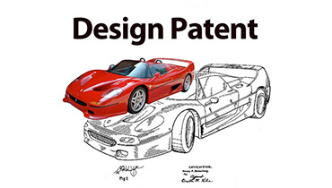
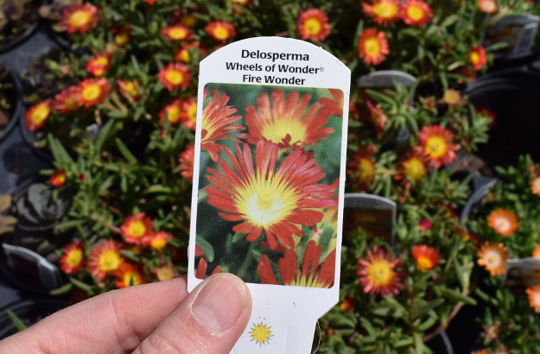
Types of Patents
There are three types of patents - Utility, Design, and Plant.
Utility Patent
  Utility patents may be granted to anyone who invents or discovers any new and useful process, machine, article of manufacture, or compositions of matters, or any new useful improvement thereof. By far, most patent applications filed at the USPTO are utility applications.
Design Patent
  Design patents may be granted to anyone who invents a new, original, and ornamental design for an article of manufacture.
Plant Patent
  Plant patents may be granted to anyone who invents or discovers and asexually reproduces any distinct and new variety of plant.

Slide 37
Requirement 3
Do EACH of the following:
  Define the term intellectual property. Explain which government agency oversees the protection of intellectual property, the types of intellectual property that can be protected, how such property is protected, and why protection is necessary.
  Explain the components of a patent and the different types of patents available.
  Examine your Scouting gear and find a patent number on a camp item you have used. With your parent’s permission, use the Internet to find out more about that patent. Compare the finished item with the claims and drawings in the patent. Report what you learned to your counselor.
  Explain the term patent infringement.

Slide 38
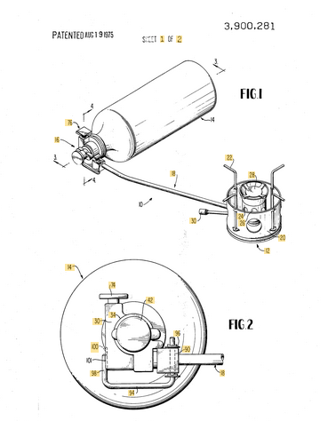
Camping Item Patent
US3900281A
Click on the following link and type in the Patent Number in the search space to look up a patent.
  Google Patent Search
Compare the finished item with the claims and drawings in the patent. Report what you learned to your counselor.
Backpacking Stove Patent

Slide 39
Requirement 3
Do EACH of the following:
  Define the term intellectual property. Explain which government agency oversees the protection of intellectual property, the types of intellectual property that can be protected, how such property is protected, and why protection is necessary.
  Explain the components of a patent and the different types of patents available.
  Examine your Scouting gear and find a patent number on a camp item you have used. With your parent’s permission, use the Internet to find out more about that patent. Compare the finished item with the claims and drawings in the patent. Report what you learned to your counselor.
  Explain the term patent infringement.

Slide 40

What Is Patent Infringement?
One commits patent infringement by making, using, offering to sell, or selling something that contains every element of a patented claim or its equivalent while the patent is in effect without the permission of the patent holder.
Does not require knowledge of patent.

Slide 41
Requirement 4
Discuss with your counselor the types of inventions that are appropriate to share with others without protecting and explain why. Tell your counselor about one unpatented invention and its impact on society.

Slide 42

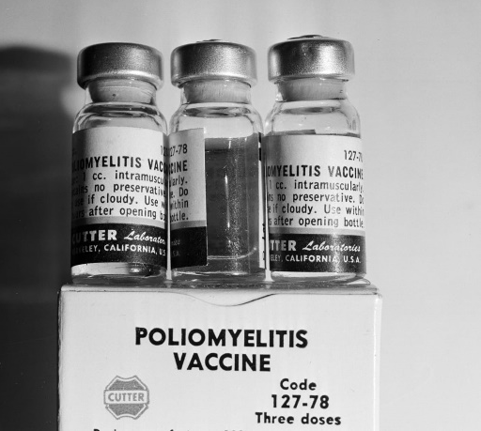


Nonpatented Inventions
Not all inventions are patented.
Inventors may decide that their inventions can be of such great help to people in the world that they choose not to pursue a patent, thus allowing the invention to he used by anyone in need.
Computer Mouse
Polio Vaccine
Matches
Magnetic Strip

Slide 43
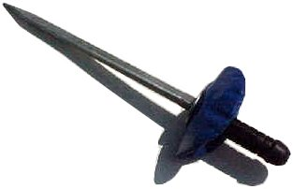
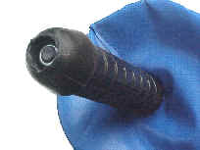
Nonpatented Inventions
Carl Dietrich’s PickProd, the blast-safe demining pick for safer removal of antipersonnel landmines in environments with hard-packed earth.
This tool is designed to be used to break up the ground while keeping the user’s hand low in the event of a detonation.
Made from “T” section steel, the Pick-prod has a blade that can be used to pick at the ground with considerable force without bending.
In softer ground, a twisting movement breaks up the ground more efficiently than a bayonet.
The user’s hand is protected by a pliable blast-shield in front of a handle

Slide 44

Nonpatented Inventions
Another example of a nonpatented invention is computer software that is considered open source.
This means that anyone can use the software without paying a fee to the inventor.
The Linux operating system is a good example of open source software.
Linus Torvalds is the “father” of Linux, which he began developing when he was a college student in Finland during the early 1990s.
His goal was to create a UNIX-like operating system for home use.
He began creating the system, working long, hard hours until, at age 22, he completed a rough version. He was guided by Design of the UNIX Operating System, written by Maurice J. Bach.
He called his system Linux, a combination of UNIX and his name, and posted the source code on the Internet, free of charge.
Because it is open, many people have contributed—and continue to contribute—to its development.
Tux the penguin
mascot of Linux

Slide 45

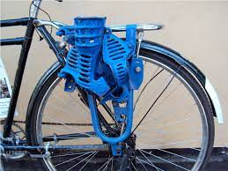
Nonpatented Inventions
Jodie Wu, a 2009 MIT graduate, and Bernard Kiwia, a Tanzanian bike mechanic and inventor, put their heads together to create the corn sheller in 2008.
Wu founded Global Cycle Solutions (GCS), a social enterprise that took the sheller to villages around Tanzania.
This bicycle-powered device, which was ﬁeld tested in Tanzania, shells corn 40 times faster than by hand.
This frees people of manual labor and generates an income from the sale of excess corn kernels.

Slide 46
Requirement 5
Choose a commercially available product that you have used on an overnight camping trip with your troop. Make recommendations for improving the product, make a sketch that shows your recommendations, and discuss your recommendations with your counselor.

Slide 47
Camping Equipment Improvement
Think inventively about how to make your camping equipment more useful. What problems do you have with your equipment? Can you think of any solutions? While this might be routine problem solving, it is an excellent way to start inventing.
 | Current Usefulness | Improving Marketability and Appearance | Improving Function
LED Lantern | Used for lighting entire camp area | Different sizes needed; could use a transport case. | Needs to be adjustable for different light intensity. Needs to hang more easily.
Flashlight | Used when camping at night for making trips to tents or bathrooms. | Choice of colors and sizes would be welcome. | Needs to be waterproof. Needs to be brighter.
Multi-Tool | Used as a screwdriver, can opener, pliers, etc. | A selection of colors for easy identification would be beneficial. Customize with name. | Additional features might include a carabineer to hang on the outside of a pack for quick access.
Hiking Shoes | Used for walking and hiking on varying ty0pes of terrain. | Different graphics on shoes, maybe camouflage. | Make boots fireproof.
Notes:
Propane Lantern
Flashlight
Leatherman® Multi-Tool
Hiking Shoes

Slide 48
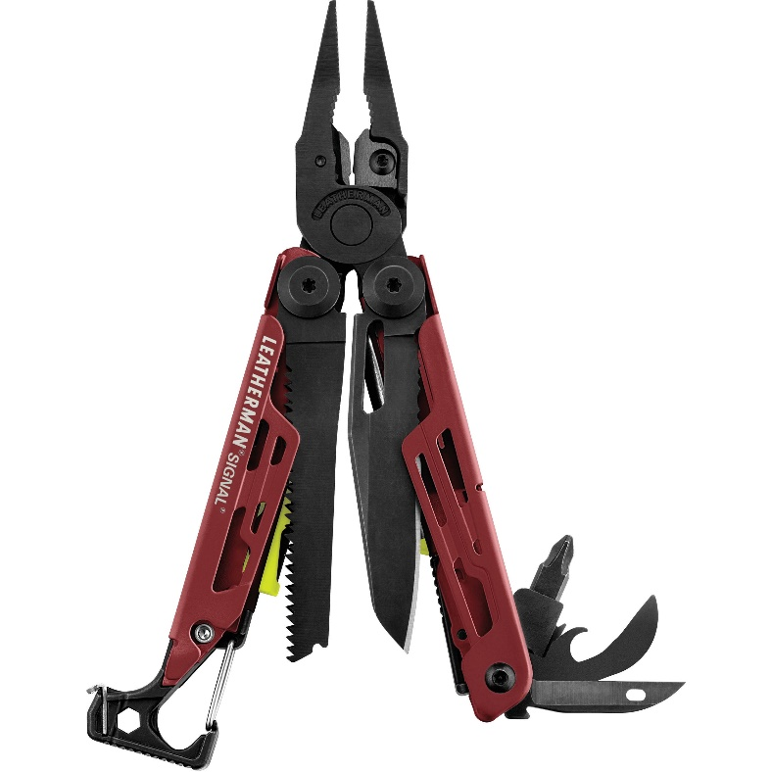
Improvements for a Multitool
Additional features might include a carabineer to hang the Leatherman on the outside of a pack for quick access.

Slide 49
Requirement 6
Think of an item you would like to invent that would solve a problem for your family, troop, chartered organization, community, or a special-interest group. Then do EACH of the following, while keeping a notebook to record your progress:
  Talk to potential users of your invention and determine their needs. Then, based on what you have learned, write a proposal about the invention and how it would help solve a problem. This proposal should include a detailed sketch of the invention.
  Create a model of the item using clay, cardboard, or any other readily available material. List the materials necessary to build a prototype of the item.
  Share the idea and model with your counselor and potential users of your invention. Record their feedback in your notebook.

Slide 50
Invention Notebook Format and Procedures
A notebook is a permanent record of your ideas.
The binding ideally should be sewn and not spiral bound, preventing pages from easily being torn out or lost.
Number and date each page of your notebook.
Be sure to list dates chronologically and do not skip pages.
After you have recorded your ideas and findings, add a suitable title to each page.
Supplement your entries with hand sketches.
If you add something printed to your notebook, tape it in securely.
All entries should be written with a pen, not a pencil.
If you make a mistake, cross it out with a single line and add a note about what the error was.
It is important to have the bottom of each page in your notebook witnessed, signed, and dated by someone who understand what you are describing.
Be aware that notebooks become permanent records and can be used to establish who was “first to invent” an item.
  U.S. Patent law states the inventorship is based on “first to invent,” not “first to file” a patent application.

Slide 51

Invention and Design Cycle
When you see a problem that needs to be solved, write it down.
When you come across something that doesn’t work the way you think it should, write down ways to make it better.
Once you have listed your ideas, think about how you would turn these ideas into inventions. Identify the ONE idea that would be fun and feasible to work on.
Keep in mind that an invention is useful, unique, and can be made to work.

Slide 52
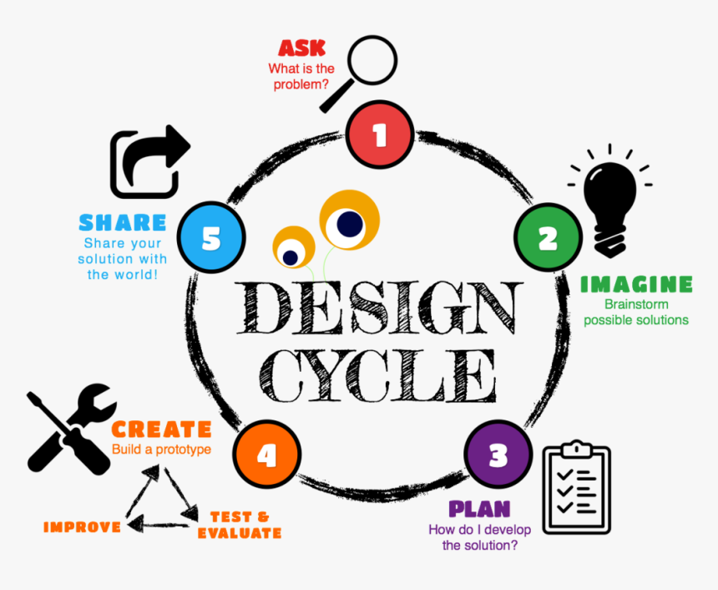
Using the Invention and Design Cycle
ASK
  Ask a question about an everyday problem that you would like to solve. Inventions can be almost anything created to solve a problem or meet a need. Examples include pencils, cups, cell phones or processes to move heavy objects.
IMAGINE
  Use your knowledge of math and science to imagine a solution to the problem that you have chosen. Look online (with parents’ permission), read books, and interview potential invention users. Brainstorm possible solutions and choose the best possible solution.
PLAN
  Make a plan and explain it. Draw a diagram and label the parts of your diagram.
CREATE
  Make a list of materials you would like to use in your invention. Collect the materials you will need for your invention. It is best to borrow, make, or use inexpensive materials. Build your invention according to your plan. Keep a list of the difficulties you run into and how you address them.
IMPROVE
    See if it works. Keep track of when and how you tested it. Have other people test it. Evaluate the results. Find any problems that need improvement. Improve your design to make it better!
SHARE
    Share your solution with the world!

Slide 53
Requirement 7
Build a working prototype of the item you invented for requirement 6*, then test and evaluate the invention. Among the aspects to consider in your evaluation are cost, usefulness, marketability, appearance, and function. Describe how your initial vision and expectations for your idea and the final product are similar or dissimilar. Have your counselor evaluate and critique your prototype.
*Before you begin building the prototype, you must share your design and building plans with your counselor and have your counselor’s approval.

Slide 54
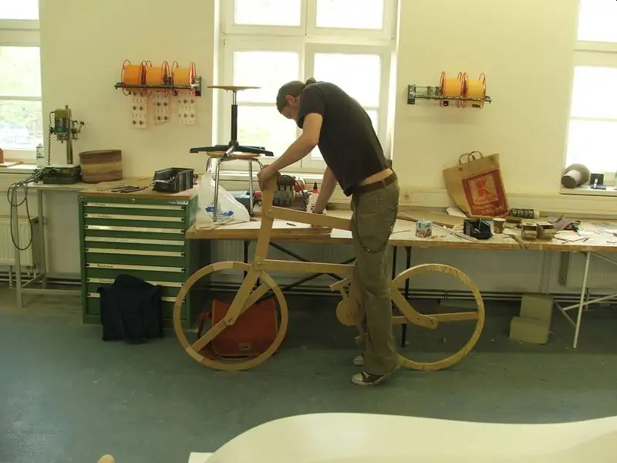
Building a Prototype
A prototype is a three-dimensional version of your vision.
It may be scaled down in size, but is a working model.
Start with a handmade prototype, no matter how rudimentary, made from the simplest of household items.
A prototype provides advantages:
  It enables you to test and refine the functionality of your design to correct flaws.
  It makes it possible to test the performance of various materials.
  It will help you describe your product more effectively
  It will encourage others to take you more seriously.
You may need to build several prototypes to get a good one done.

Slide 55
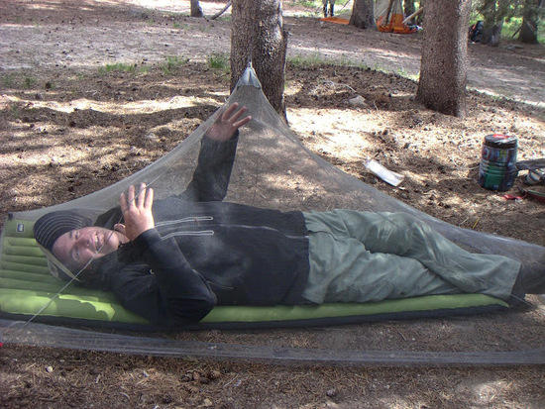
Testing Your Prototype
The final step of the invention is getting the best working model of your idea into the hands of potential users.
This is called field-testing.
Ask the users for likes and dislikes about your model.
Write those comments in your notebook and analyze them to see if you agree.
Make a list of things you would like to change when you build your next mode.

Slide 56
Requirement 8
Do ONE of the following:
  Participate in an invention, science, engineering, or robotics club or team that builds a useful item. Share your experience with your counselor.
  Visit a museum or exhibit dedicated to an inventor or invention, and create a presentation of your visit to share with a group such as your troop or patrol.

Slide 57

Robot Academy
LEGO Robotics Engineering & Coding
Robot Academy

Slide 58
Requirement 8
Do ONE of the following:
  Participate in an invention, science, engineering, or robotics club or team that builds a useful item. Share your experience with your counselor.
  Visit a museum or exhibit dedicated to an inventor or invention, and create a presentation of your visit to share with a group such as your troop or patrol.

Slide 59

National Inventors Hall of Fame
National Inventors Hall of Fame® (NIHF)
Located at the United States Patent and Trademark Office Headquarters, Madison Building
600 Dulany St.
Alexandria, Virginia 22314

Slide 60

Henry Ford Museum
The Henry Ford
20900 Oakwood Boulevard
Dearborn, MI 48124
313-982-6001

Slide 61
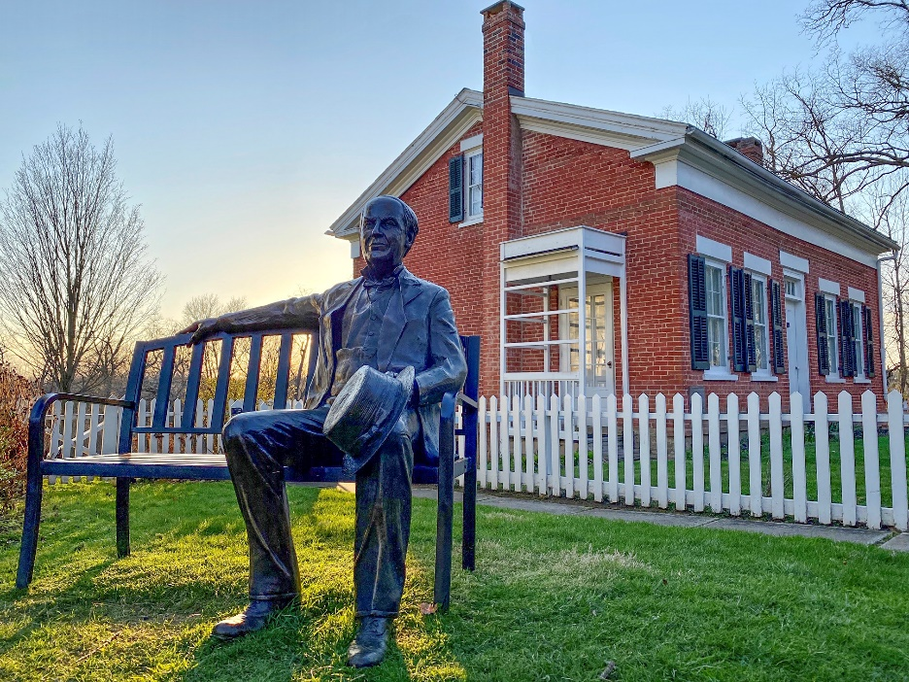
Thomas Edison Birthplace Museum
9 N Edison Dr.
Milan, OH 44846
Phone: (419) 499-2135
Email: tomedison@tomedison.org

Slide 62

Toledo Museum of Art Glass Pavilion
2445 Monroe Street
Toledo, OH 43620
(419) 255-8000

Slide 63

Imagination Station
1 Discovery Way
Toledo, Ohio, 43604
419.244.2674

Slide 64
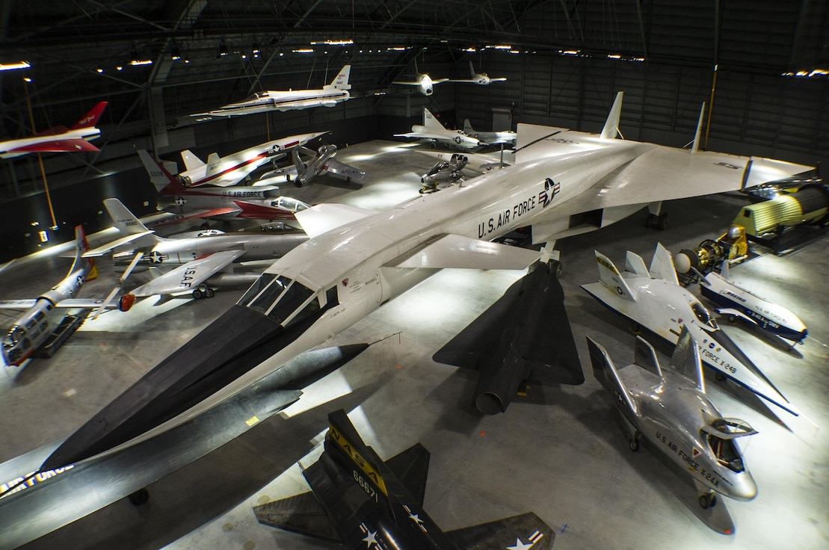
Wright Patterson Airforce Museum
1100 Spaatz Street
Wright-Patterson AFB Ohio 45433
(near Dayton)
(937) 255-3286

Slide 65
Requirement 9
Discuss with your counselor the diverse skills, education, training, and experience it takes to be an inventor. Discuss how you can prepare yourself to be creative and inventive to solve problems at home, in school, and in your community. Discuss three career fields that might utilize the skills of an inventor.

Slide 66
Diverse Skills, Education, Training, and Experience It Takes to Be an Inventor
Curiosity - Be curious and observe the world around you. Never stop wondering WHY or asking “WHAT IF” questions.
Creativity - An inventor's primary responsibility is to develop new ideas and products. Creative thinking can help them identify and develop solutions to problems.
Persistence - Inventors may test their ideas many times before determining a product is ready for market success and learn from failures. Inventors apply persistence throughout the invention process, from developing ideas to selling products. This trait can help inventors stay motivated by focusing on their desired outcomes.
Problem-solving - Inventors often develop problem-solving skills that help them analyze their inventions and identify areas in need of improvement.

Slide 67
Diverse Skills, Education, Training, and Experience It Takes to Be an Inventor
Focus on STEM subjects in school (science, technology, engineering, and mathematics). Take a lot of science courses in school.
You should also take courses on technology or engineering, computer programming, or wood shop.
Take a lot of high level math courses as a good knowledge of math is essential to becoming an inventor.
English helps you communicate your ideas to others.
Art classes help you develop creativity and imagination.

Slide 68
Career Fields that Utilize Inventiveness
Industrial Designer
Designers come up with new ideas, developing the concepts behind new products or processes and drawing them, either by hand or using computer-assisted design.
Designers work in combination with engineers or engineering technicians to bring their designs into reality.
They may also do market research, develop working prototypes and work with other people to determine if the new product fills a marketable need or provides a solution.
They may also work on other people's designs to determine if the product design is feasible and marketable and to determine production costs.

Slide 69
Career Fields that Utilize Inventiveness
Engineer
Many aspiring inventors first obtain a graduate or post-graduate degree in engineering.
An engineer comes up with new ideas for products or optimizes a current product or manufacturing process.
He takes his or other people's ideas and translates them into blueprints. He may also supervise the building of prototypes for testing and implementation.
Fields include mechanical and electrical engineering, electronics, industrial engineering, aerospace, biomedical engineering and chemistry.

Slide 70
Career Fields that Utilize Inventiveness
Computer Scientist
An ability and desire to invent is valuable in the fields of computer science and software development.
Computer scientists work in conjunction with designers and engineers to develop hardware or software for computers or robots.
They may come up with the idea for a new robot for use in manufacturing, in aerospace, or in the home; the Mars Rover and the robotic vacuum are two examples of computerized robots offering practical applications.
Computer scientists often create new computer hardware designs used in a variety of products and applications.

Slide 71
Career Fields that Utilize Inventiveness
Independent Inventors
Independent inventors work for themselves.
They either come up with ideas for new inventions, patent their ideas and sell them to large companies or come up with the financing to manufacture and market their own products.
Independent inventors often work in conjunction with a patent attorney to secure their patents.
While no formal training is needed to become an independent inventor, it helps to have mechanical aptitude, artistic ability and experience in business development and marketing.

